Slide 1

Blockchain Solution for vehicle collateralized Loans

Slide 2
Current solution to obtain a loan from the centralized banks
When a user is trying to buy a vehicle, if the user wishes to opt for a loan, the user approaches multiple financial institutions with a request. These institutions have their criteria to arrive at an amount that can be disbursed and a rate of interest that can be applied.
For example, bank A may decide to provide a loan for 80% of the cost of the vehicle and at the interest rate of 8.5% to the user, while bank B might provide 90% of the amount at an interest rate of 8.65%.
Customers may be offered loans based on the car’s value, but the valuation is dependent on the bank. The valuation of a car depends on the following: Age , Condition , Depreciation value that increases with age

Slide 3
Current solution to obtain a loan from the centralized banks… continue
To provide loans, banks also look at individuals' creditworthiness. This is done generally by looking at your credit history, income sources and credit scores from rating agencies.
If a user uses a loan to buy a car, though the user maintains primary ownership of the vehicle for all practical purposes, the user cannot sell the car against which a loan is taken without paying back the loan amount to the bank and getting its approval.
The line is marked on the customer’s certificate of registration (the RC book), an important documentary proof of ownership at the regional transport office (RTO). This would restrict the sale of the car until the hypothecation is removed. One needs to obtain a no-objection certificate from the bank and give it to the RTO before proceeding to do so.
This process in the current scenario is centralized as it is the banks that enjoy all the advantages and dictate terms.

Slide 4
Actors involved in the centralized solution ?
Buyer
Banks
RTO
Insurance company
Seller of Car/ Cat Manufacturers

Slide 5
Challenges in the current system for obtaining a Loan through centralized solution
The process is not transparent and customer friendly from the buyer’s point of view .
Debtors will include banks and NBFC’s and hence there is central authority involved in disbursing the loan .
Background checks for debtors are performed in a rigorous manner. This further leaves the customer dissatisfied .
Tracking of vehicle ownership although can be tracked transparently , there is scope of data being manipulated as the tracking of information of the vehicle is done from a centralized database .

Slide 6
Can decentralized Finance technology like block chain can help to achieve the following objectives ??

Slide 7
What is decentralised finance?
Decentralized finance uses currency, peer-to-peer money, and digital currency all refer to bank-free methods of transferring wealth or ownership of any other commodity without needing a third party. Most centralized, and some decentralized, markets use fiat currency—or physical money issued by a central bank, like U.S. dollars whereas Decentralized finance, or DeFi, aims to use technology to remove intermediaries between parties in a financial transaction.
We can use DEFI technology specifically in our use case ..wherein the person who Is in need of the car can use DEFI technology to disburse the final amount to the car manufacturer and the lender of the amount could be any one who has digital capability to disburse the loan .

Slide 8
Blockchain will help in making the process more transparent and customer friendly
The Blockchain solution ecosystem involves Buyers, Lenders ,RTO ,Insurance company , Seller of Car/ Car Manufacturers .All the stakeholders will have real time access to the blockchain database , this will reduce the overall need for communication between the parties . The necessary information can be accessed from the blockchain database

Slide 9
Increase the reach of debtors and do not limit them to financial institutions
SInce the blockchain solution will allow the lenders to publish the rate of interest they are willing to offer with their collateral requirements and the buyers could publish the interest they are willing to pay (with the details of assets they are willing to put as collateral , this will allow the blockchain solution to be a seamless market place wherin the necessary communication between the lender and the borrower can be done .

Slide 10
Ensure background checks for debtors are performed
The lenders in the block chain ecosystem can clearly establish and publish the rate of interest along with the collateral details they will need to dispurse the loan amount , The borrower will have to list any of his digital assets such as NFT’s , Cryptocurrency , Physical assets(its digital representative) which will necessarily be collateralized to have access to the loan amount . Since all these assets are in digital form , the background check is smooth and seamless unlike how rigourous it could get for a centralized bank .

Slide 11
Track vehicle ownership transparently
The vehicle ownership will need to be represented In the digital form as a compulsory requirement in the blockchain . Hence , the data is now immutable and transparent for it to be accessed by all the stakeholders in the blockchain solution .

Slide 12
Interfacing them with blockchain (e.g., as oracles)
The car manufacturers ,RTO , Insurance companies can connect their database using oracles or sidechains . This will further enable the smooth communication between al the actors involved .

Slide 13
Actors involved in the decentralized solution
Borrower
Lender
Blockchain solution interface
Car manufacturer
RTO
Insurance companies.
We are looking at the Block chain solution being offered by car manufacturers to the End user and the actors involved in thr ecosystem are as per above .

Slide 14
What are the further advantages Blockchain can offer to the buyers, sellers and everyone one involved in the Ecosystem Vehicle Collateralized Loans

Slide 15
Decentralisation allows for P2P lending and democratised incentivisation to the lenders
P2P lending allows Borrower to find the lender who would best meet their requirement . This can also enable pool lending with multiple lenders and one buyer .
The lender who may have cryptocurrency can lend they necessary amount to the borrower with the rate of interest and conditions he wishes to choose.

Slide 16
Easing audit trail management in case of loan defaults or any other complications
Since the borrower will be keeping any of his digital assets as collateral , these digital assets will be transfer to the lender in case of any loan default .

Slide 17
Loans across borders allow for more liquidity opportunities
Since we are talking of the Blockchain solution in the digital word, The loan amount can be transferred from and to any part of the world .

Slide 18
Verified ownership trail of the asset
The assets would be represented in the blockchain which would make it immutable , Hence all the details of ownership of vehicle along with the records cannot be tampered .

Slide 19
Operational requirements for managing physical asset registration and verification Use of NFTs (creation, asset ownership and transfers)
We have already looked at How is it maintained the current centralized system, How can it be mainlined in the decentralized system?
In a decentralized system , we can have smart contracts with functionality of creating , owning and transferring ownership of the assets by tokenizing them .

Slide 20
How would the lender be incentivized? What would be the moving parameters involved?
Since we are looking at the the solution being provided by the car manufacturer, they will have the ecosystem of lenders and borrowers and the incentivation will be as per the lender’s published interest rate . Unlike centralized system , this will be a secured P2P transaction between lenders and borrowers.

Slide 21
Risk assessment for creditors
The Creditors will be secured to give credit based on the collateral to be provided by the debtor /customer who is buying the car and lending for the same .

Slide 22
Marketplace for the discovery of the amount of credit extended and interest rates
The credit extension will be offered to the borrower according to the collateral he is willing to keep for the vehicle .there will be specific solutions according to the valuation of the collateral.

Slide 23
Ability to pool credit for small creditors and distribution of incentives
The borrower has an option to pool credit frm several lenders . This will enable him to probably have a better rate at the same time the lenders will be able to distribute the risks .

Slide 24
Loan defaults and how to manage them
The collateral will be taken from the borrower in case of default of loan .

Slide 25
Choice of one or more block chain frameworks, which, why and how?
This could be a solution offered on Ethereum with lenders, borrowers, RTO , insurance company and car manufacturer

Slide 26
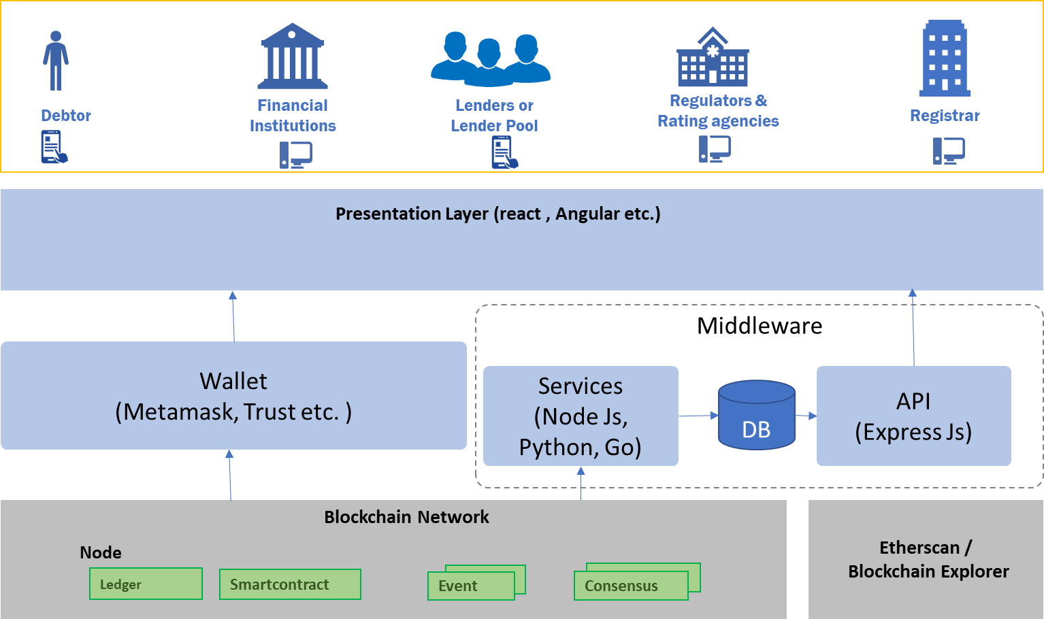
High level technical architecture diagram

Slide 27
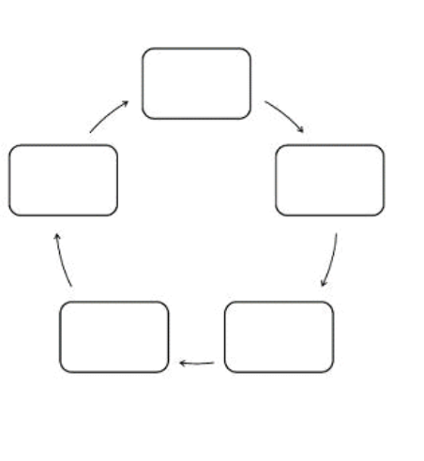
User workflow diagram for all parties involved
Car Manufacturer
Borrower
Lender
Insurance company
RTO
Car Manufacturer
RTO
Borrower
Insurance company
Lender

Slide 28
Barrier of entry analysis
User experience for Onboarding of Debtors and Lenders would be key for adoption of the platform.
Initially the current vehicle registry system will need to run in parallel with the new digital asset registry.
Existing Vehicle registry system, rating agencies and regulators should be able to provide reliable oracle services for the network.
Debtors may hesitate to rely on crypto assets as collaterals because of the lack of clarity on the crypto regulations.
Along with transparency, the system will need to offer competitive loan amount and interest rates to attract new Lenders as well as debtors.
New users may lack trust because of the historical Security vulnerabilities of the smart contracts and lack of Interoperability with existing or future networks.

Slide 29
Conclusion and recommendations
Digital marketplace enhances operational efficiency and allows more lenders and debtors to benefit from the transparent business processes and auditable system of records.
Digitization of the business processes and reusable KYC ensures Faster turnaround time
Network could be enhanced to form a Immutable digital registry for ownership, accident and maintenance records for private and commercial vehicles.
The system will need to offer competitive loan amount and interest rates to attract new Lenders as well as debtors.
The network could be enhanced in the future to include many more user-friendly features

Slide 30
Link for the video presentation
https://drive.google.com/file/d/1ta5m7qQb8Jvwxct7HUrfJPvLhWcNDA9Q/view

